Slide 1
Introduction to OpenCV, SkImage, SimpleITK
Hengyang Lu
06/12/2018
Pythonic Image/Video Bioinformatics Workshop No.3

Slide 2
Outlines
01. Image Processing and Image Analysis
02. Image I/O
03. Basic Image Processing using scikit-image

Slide 3
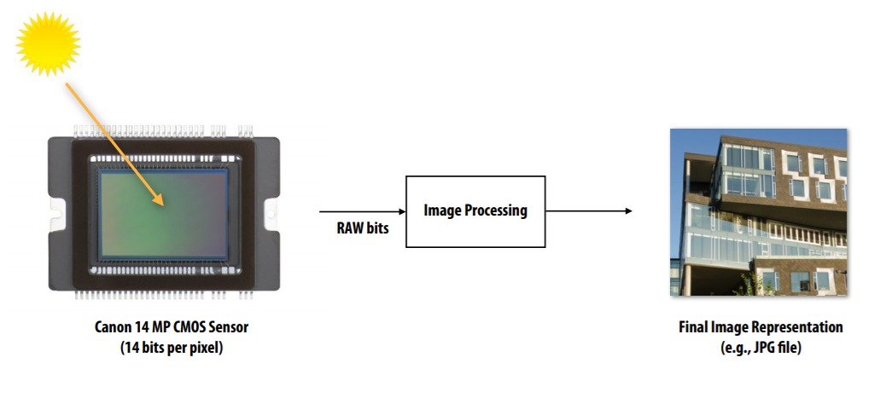
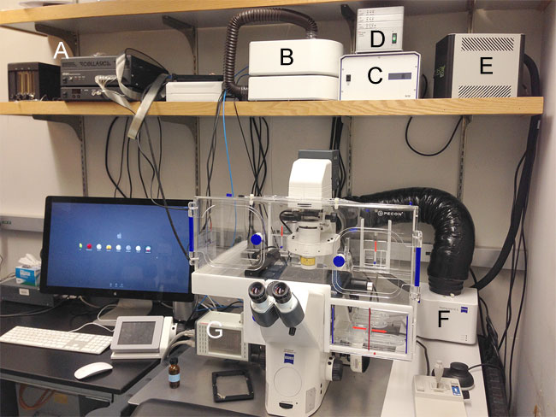
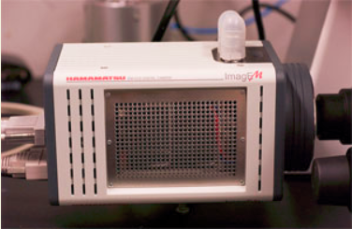
Image Capturing
The AxioObserver has a Hamamatsu 9100-13 EMCCD camera for imaging extremely low fluorescence
http://microscopy.berkeley.edu/instruments/Z1.html

Slide 4
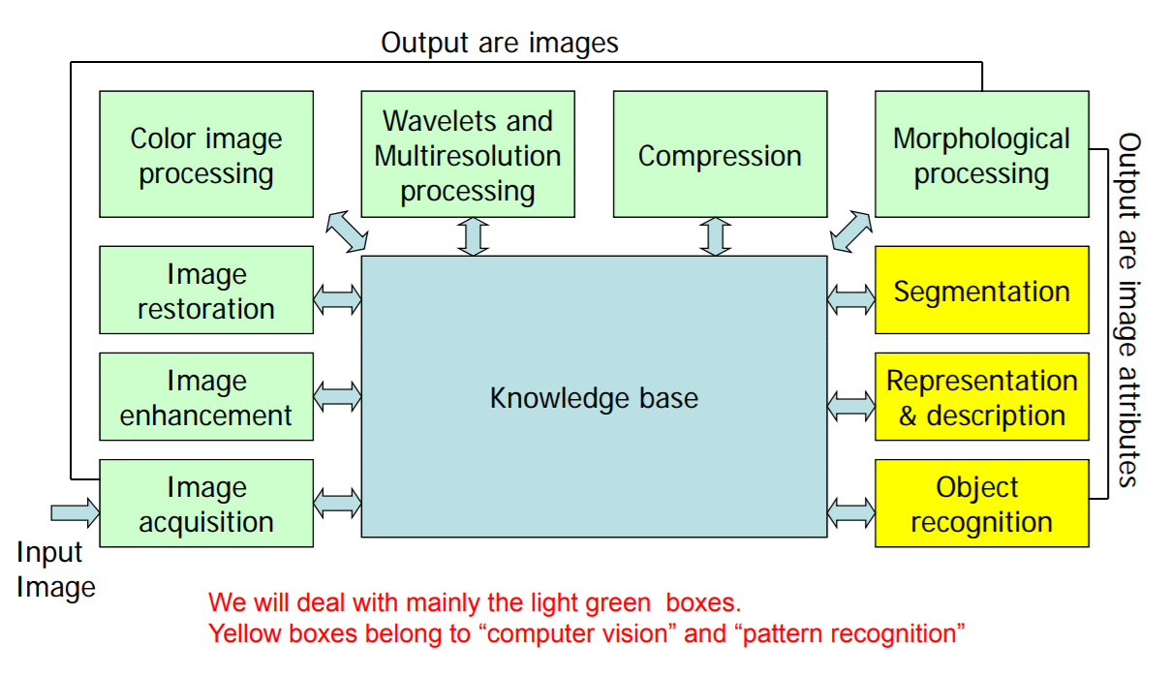
Image Processing
http://eeweb.poly.edu/~yao/EL5123/lecture1_intro.pdf

Slide 5
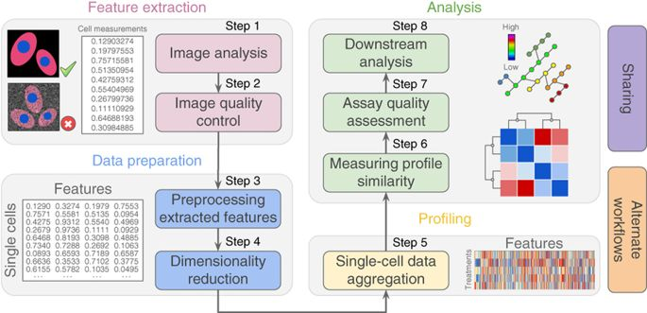
Image Analysis pipeline
Caicedo, Juan C., et al. "Data-analysis strategies for image-based cell profiling." Nature methods 14.9 (2017): 849.

Slide 6



Scikit-Image, OPENCV & SimpleITK
Extends scipy.ndarray module
2. Collection of image processing
algorithms written in python;
3. Handy modules: data, io, filter
Python Wrapper for OpenCV
Implemented using C++;
2. Rich support for computer vision
And machine learning supports;
3. Faster speed;
Python Wrapper for ITK;
Rich support for medical image
formats and applications.

Slide 7
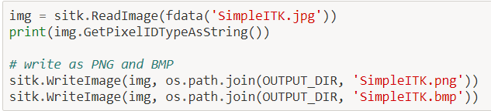
Image I/O: load and save images
http://insightsoftwareconsortium.github.io/SimpleITK-Notebooks/Python_html/03_Image_Details.html
In Skimage
Skimage.io.imread(fname)
Skimage.io.imread_collection(load_pattern, conserve_memory=True)
Skimage.io.imsave(fname, image_array)
Skimage.io.imshow(image_array)
In OpenCV
Cv2.imread(img_fname, type)
Cv2.imwrte(img_fname, img_array)
Cv2.imshow(img_array)
In SimpleITK:

Slide 8
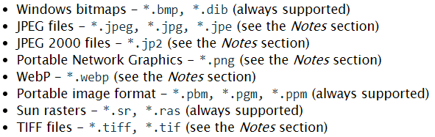
Image I/O: supported image format
https://docs.opencv.org/3.0-beta/modules/imgcodecs/doc/reading_and_writing_images.html
https://itk.org/Wiki/ITK/File_Formats
Supported File Formats of OPENCV | Supported File Formats in SimpleITK | Supported File Formats in Skimage
 | Tiff Jpeg Png BMP DICOM NRRD GE Mhd others | jpg png, bmp tiff ………

Slide 9
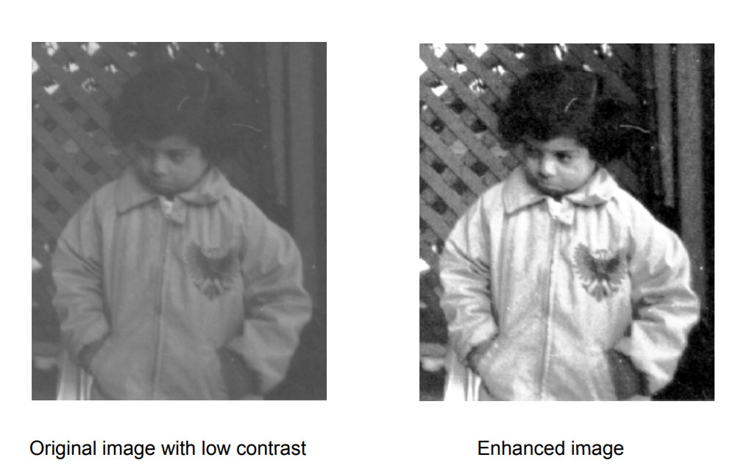
Image Processing Examples using Skimage
Image Enhancement
Thresholding
Morphological Operations
Colors
Edges and Corners
Transform

Slide 10
Image enhancement
Image enhancement is the process of adjusting digital images so that the results are more suitable for display or further image analysis.
Previously mentioned:
Negative Image
Gamma Correction
Histogram Equalization
And more:
Noise reduction
Image Smoothing
Image Sharpening: Sobel, Prewitt, Laplacian Operators
White Balance
Etc.

Slide 11
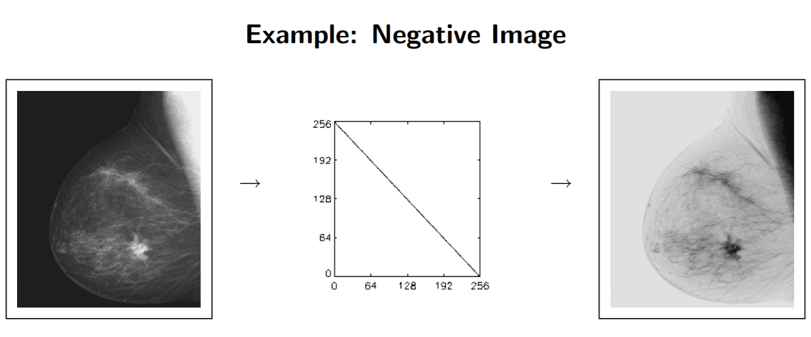
Inverse image or negative image
https://www.cis.rit.edu/class/simg782/lectures/lecture_05/lec782_05_05.pdf

Slide 12
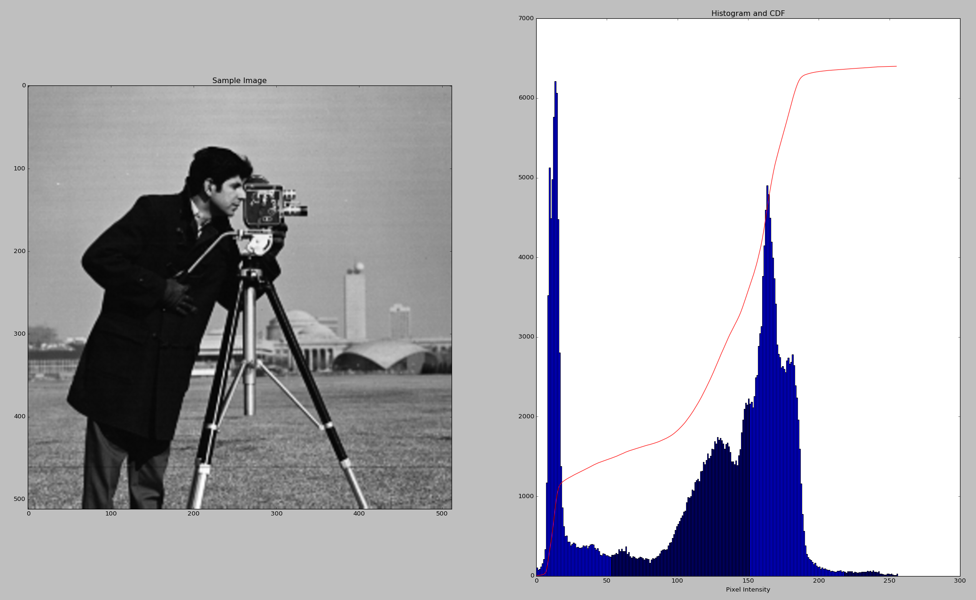
Plot Image Histogram
https://docs.opencv.org/3.1.0/d1/db7/tutorial_py_histogram_begins.html

Slide 13
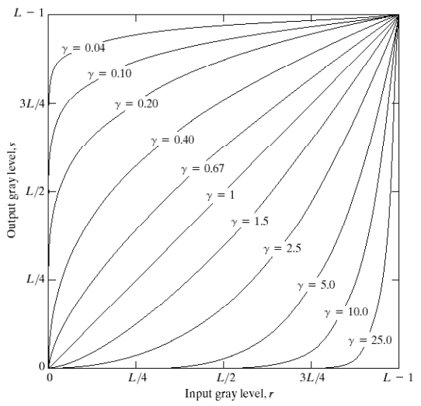
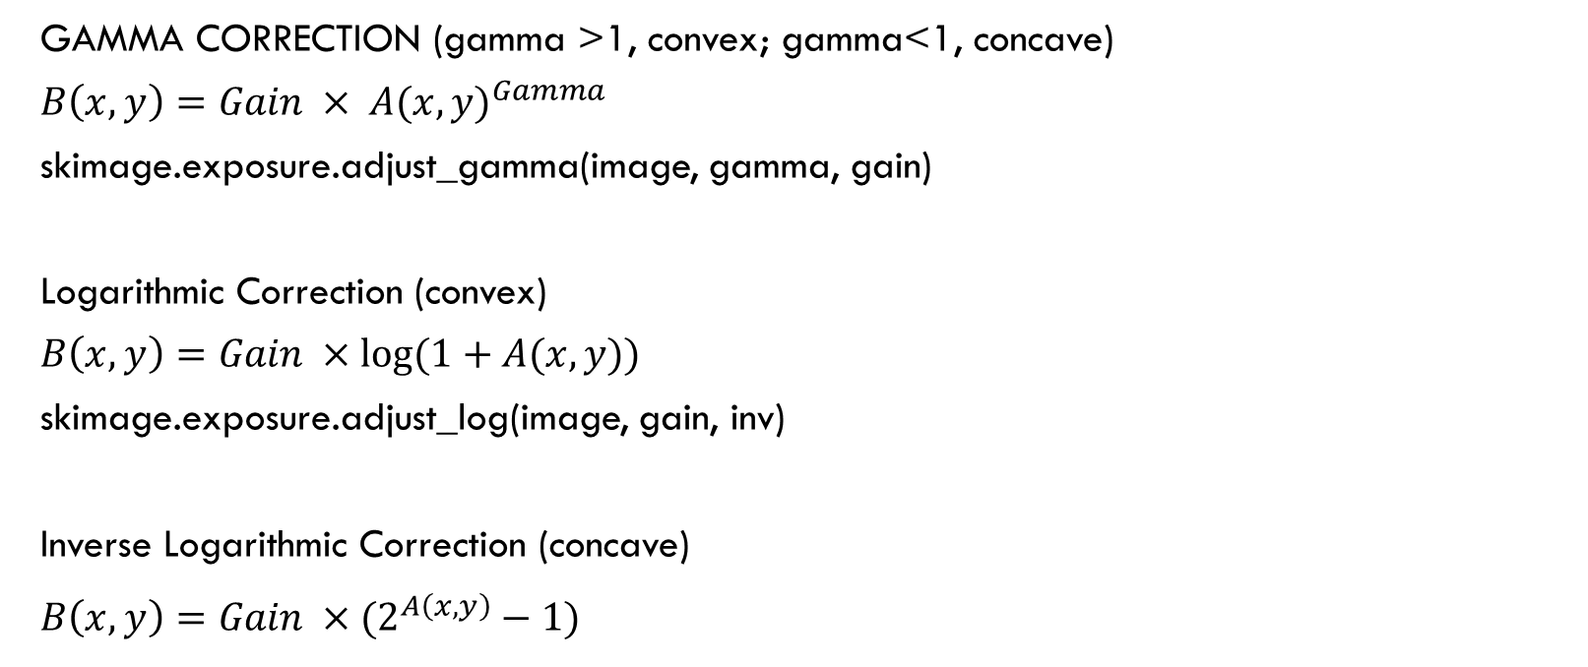
Gamma and log contrast adjust
GAMMA CORRECTION (gamma >1, convex; gamma<1, concave)
$B\left(x,y\right)=Gain × {A(x,y)}^{Gamma}$
skimage.exposure.adjust_gamma(image, gamma, gain)
Logarithmic Correction (convex)
$B\left(x,y\right)=Gain ×log⁡(1+A(x,y))$
skimage.exposure.adjust_log(image, gain, inv)
Inverse Logarithmic Correction (concave)
$B\left(x,y\right)=Gain ×(2^{A\left(x,y\right)}−1)$
http://eeweb.poly.edu/~yao/EL5123/lecture3_contrast_enhancement.pdf

Slide 14
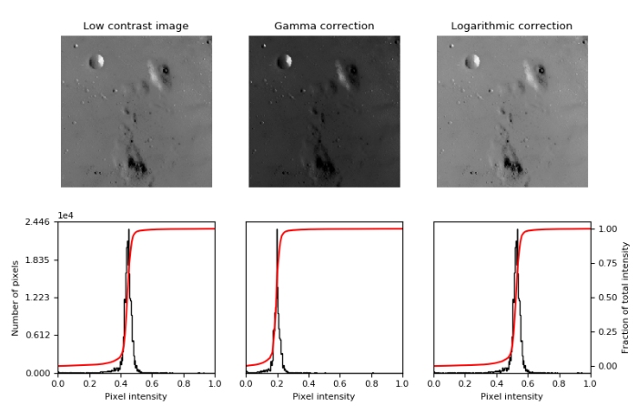
Gamma and LOG Contrast adjust

Slide 15
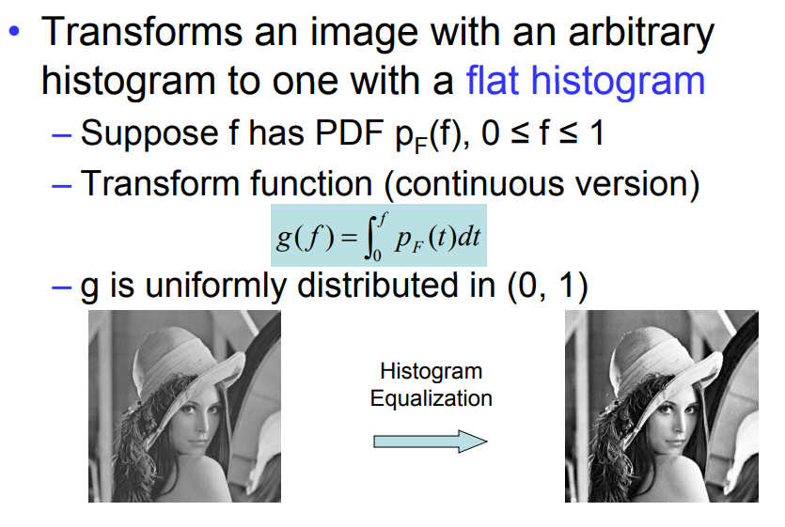
Histogram Equalization
http://eeweb.poly.edu/~yao/EL5123/lecture3_contrast_enhancement.pdf

Slide 16
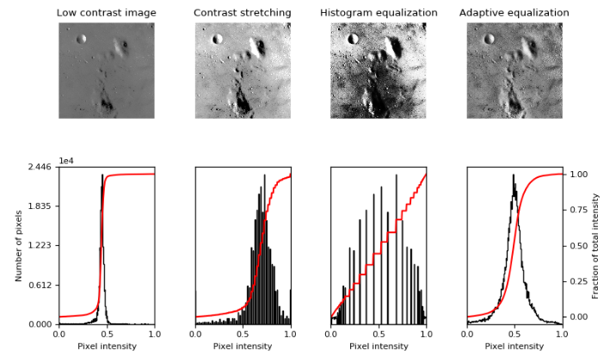
Histogram Equalization

Slide 17
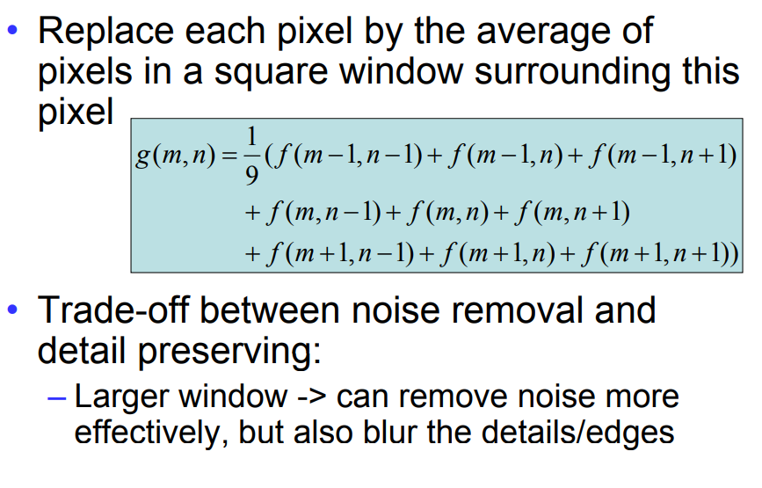
Image smoothing: Mean Filter
http://eeweb.poly.edu/~yao/EL5123/lecture5_filtering.pdf

Slide 18
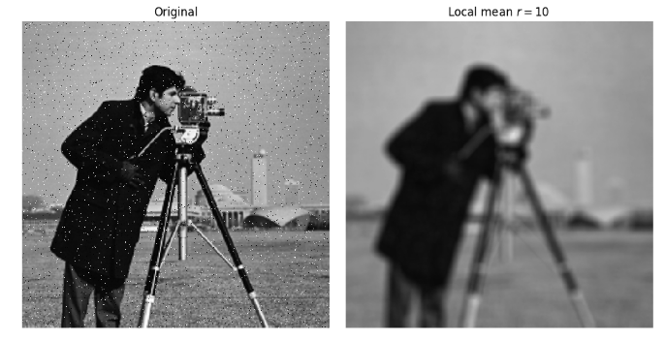
Image Smoothing: Mean Filter

Slide 19
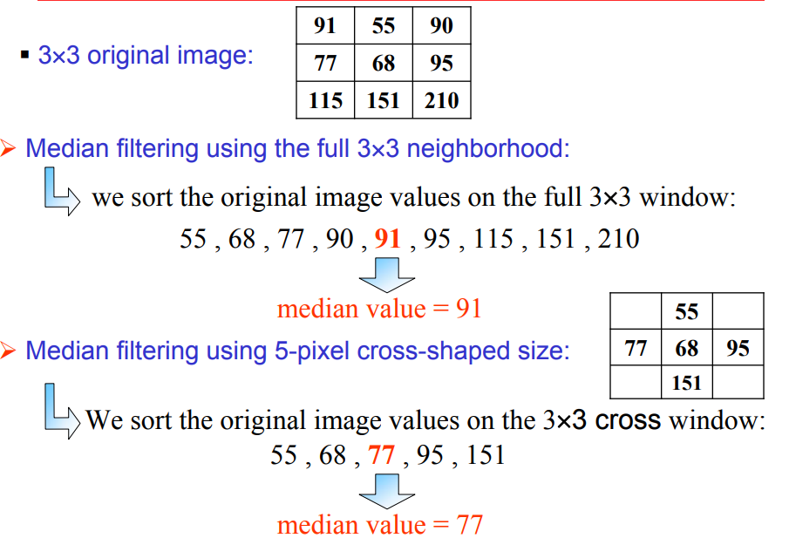
Image Smoothing: mean filter
http://www.unit.eu/cours/videocommunication/Non-linear_filtering.pdf

Slide 20
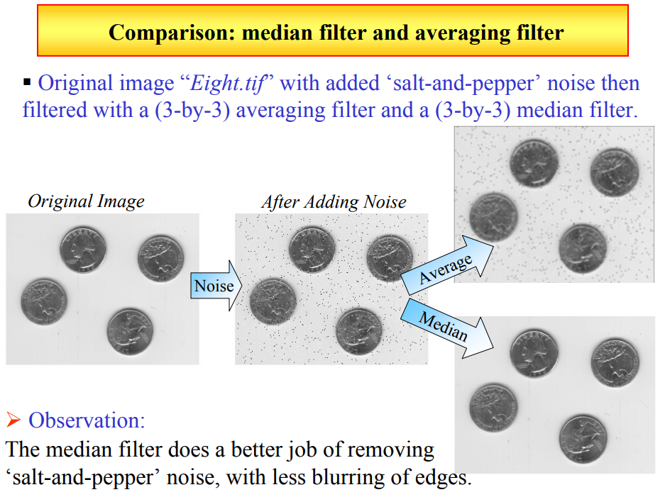
Image smoothing: Median Filter
http://www.unit.eu/cours/videocommunication/Non-linear_filtering.pdf

Slide 21
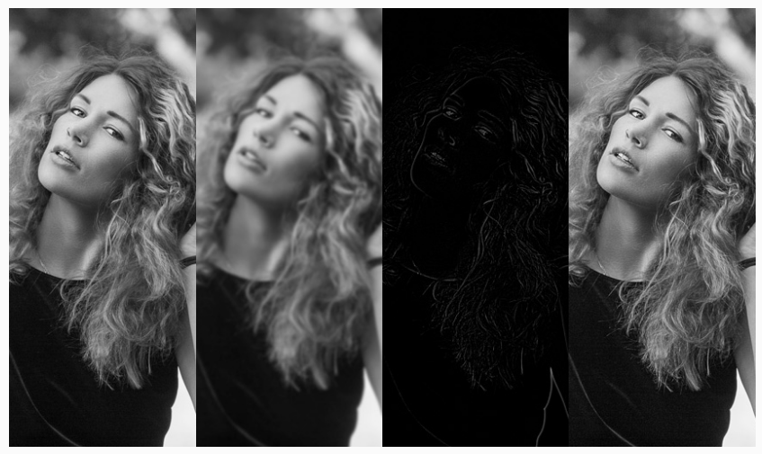
Image sharpening
Sharpness is a combination of two factors
Resolution
Acutance
Different techniques:
Super-resolution
Contrast Enhancement
Deblur/Deconvolution
A typical example: Unsharp Masking
enhanced image = original + amount * (original - blurred)
https://photography.tutsplus.com/tutorials/what-is-image-sharpening--cms-26627

Slide 22
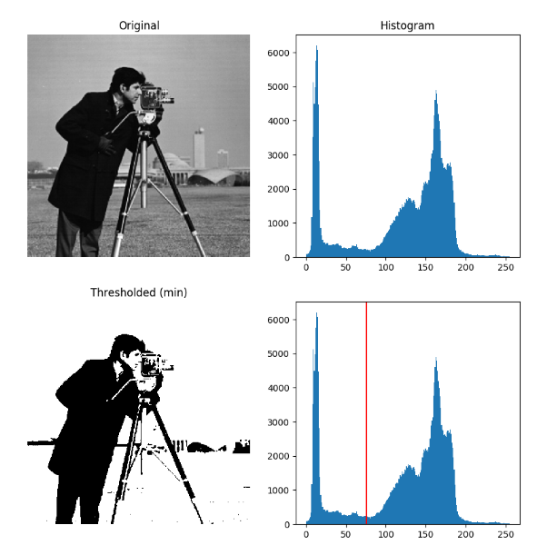
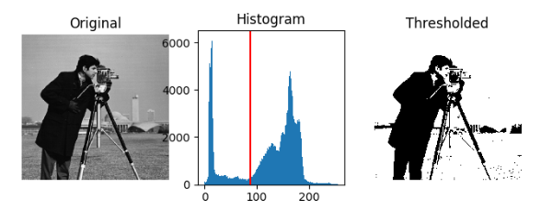
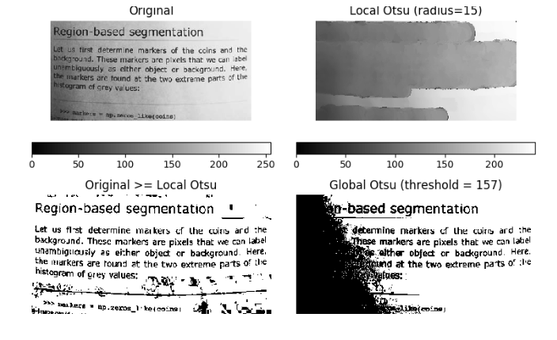
thresholding
Histogram Based
Mean value threshold skimage.filters.threshold_mean
Bimodal threshold skimage.filters.threshold_minimum
Clustering Based
K-Means
Otsu skimage.filters.threshold_otsu
Local Threshold

Slide 23
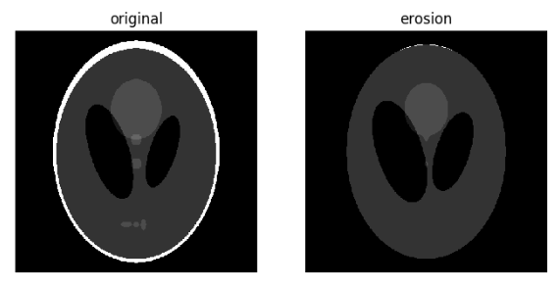
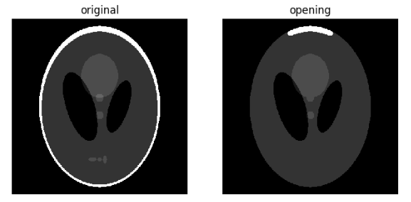
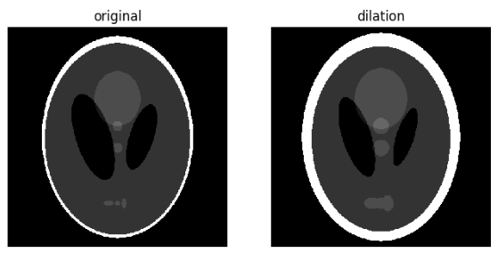
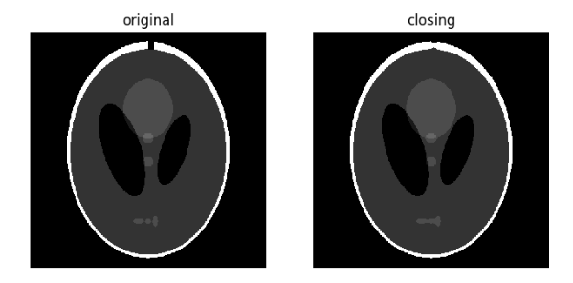
Morphological operations
Collections of non-linear operations related to the shape or morphology
Erosion
Dilation
Opening
Closing
White Tophat
Black Tophat
Skeletonize
Convex hull

Slide 24
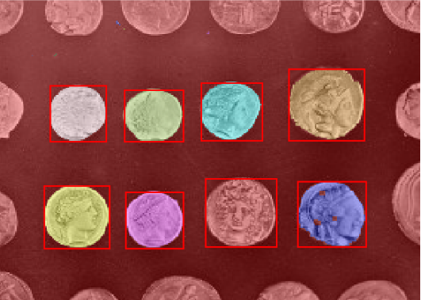
Connected components labeling
1. Thresholding with automatic Otsu method
2. Close small holes with binary closing
3. Remove artifacts touching image border
4. Measure image regions to filter small objects

Slide 25
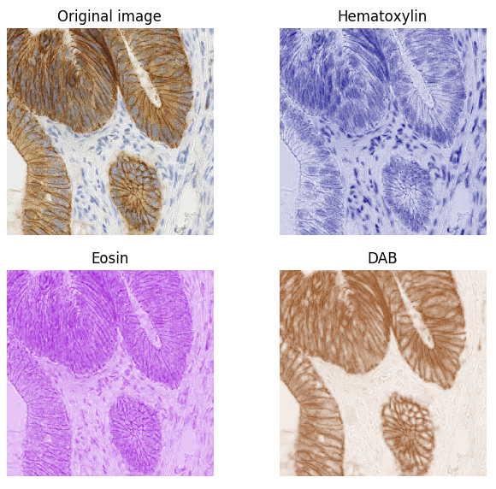
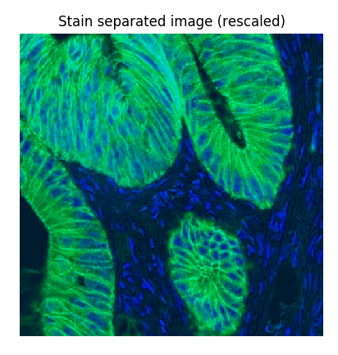
colors
Skimage.color.rgb2hed

Slide 26
Other Examples
Harris Corner Detection
Canny Edge Detection
Hough Transform
Fast Fourier Transform

Slide 27

Thank you!

